Slide 1


John Doe
Feb 1st 2025

Slide 2

Outline
Executive Summary
Introduction
Methodology
Results
Conclusion
Appendix

Slide 3
Executive Summary
Summary of methodologies
Data collection
Data wrangling
Exploratory Data Analysis with Data Visualization
Exploratory Data Analysis with SQL
Building an interactive map with Folium
Building a Dashboard with Plotly Dash
Predictive analysis (Classification)
Summary of all results
Exploratory Data Analysis results
Interactive analytics demo in screenshots
Predictive analysis results

Slide 4
Introduction
Project background and context
SpaceX is the most successful company of the commercial space age, making space travel affordable. The company advertises Falcon 9 rocket launches on its website, with a cost of 62 million dollars; other providers cost upward of 165 million dollars each, much of the savings is because SpaceX can reuse the first stage. Therefore, if we can determine if the irst stage will land, we can determine the cost of a launch. Based on public information and machine learning models, we are going to predict if SpaceX will reuse the first stage.
Problems you want to find answers
How do variables such as payload mass, launch site, number of lights, and orbits affect the success of the first stage landing? - Does the rate of successful landings increase over the years? - What is the best algorithm that can be used for binary classification in this case?

Slide 5

Section 1

Slide 6
Methodology
Executive Summary
Data collection methodology:
Using SpaceX Rest API
Using Web Scraping from Wikipedia
Performed data wrangling
Filtering the data
Dealing with missing values
Using One Hot Encoding to prepare the data to a binary classification
Performed exploratory data analysis (EDA) using visualization and SQL
Performed interactive visual analytics using Folium and Plotly Dash
Performed predictive analysis using classification models
Building, tuning and evaluation of classification models to ensure the best results

Slide 7
Data Collection
Data collection process involved a combination of API requests from SpaceX REST API and Web Scraping data from a table in SpaceX’s Wikipedia entry. We had to use both of these data collection methods in order to get complete information about the launches for a more detailed analysis.
Data Columns are obtained by using SpaceX REST API
FlightNumber, Date, BoosterVersion, PayloadMass, Orbit, LaunchSite, Outcome, Flights, GridFins, Reused, Legs, LandingPad, Block, ReusedCount, Serial, Longitude, Latitude
Data Columns are obtained by using Wikipedia Web Scraping:
Flight No., Launch site, Payload, PayloadMass, Orbit, Customer, Launch outcome, Version Booster, Booster landing, Date, Time

Slide 8
Data Collection – SpaceX API
Present your data collection with SpaceX REST calls using key phrases and flowcharts
GitHub Link
jupyter-labs-spacex-data-collection-api-v2.ipynb
dataset_part_1.csv
Request data from SpaceX API
Decode the response using .json_decode()
Request additional data from SpaceX API
Construct data into a useful dictionary
Export the data to CSV.
Clean the data and replace missing values
Filter the data for Falcon 9 launches
Convert the dictionary into a pandas dataframe object

Slide 9
Data Collection – Scraping
Present your data collection with SpaceX REST calls using key phrases and flowcharts
GitHub Link
jupyter-labs-webscraping.ipynb
dataset_part_2.csv
Request launch data from Wiki
Create BeautifulSoup object from response data
Extract table data from the response
Export the data to CSV.
Construct a pandas dataframe object
Parse HTML tables

Slide 10
Data Wrangling
The dataset includes cases where the booster failed to land successfully. Landings are categorized as follows: **True** (successful) or **False** (unsuccessful) for Ocean, RTLS (ground pad), and ASDS (drone ship). These outcomes are converted into training labels: **1** for a successful landing and **0** for an unsuccessful one.
GitHub Link
labs-jupyter-spacex-Data wrangling-v2.ipynb
dataset_part_3.csv
Analyze data and select training labels
Calculate number of launches per site
Calculate the amount and frequency of LEO and GEO launches
Export the data to CVS
Analyze the landing outcome
Calculate the mission outcome per orbital type

Slide 11
EDA with Data Visualization
Charts Plotted
Flight Number vs. Payload Mass, Flight Number vs. Launch Site, Payload Mass vs. Launch Site, Orbit Type vs. Success Rate, Flight Number vs. Orbit Type, Payload Mass vs Orbit Type and Success Rate Yearly Trend
Scatter plots illustrate relationships between variables and can be useful for machine learning if a pattern exists.
Bar charts compare discrete categories, highlighting relationships between categories and their measured values.
Line charts display trends over time, making them ideal for time series analysis.
jupyter-labs-eda-dataviz-v2.ipynb

Slide 12
EDA with SQL
Performed SQL queries
Displaying the names of the unique launch sites in the space mission
Displaying 5 records where launch sites begin with the string ‘CCA'
Displaying the total payload mass carried by boosters launched by NASA (CRS)
Displaying average payload mass carried by booster version F9 v1.1
Listing the date when the first successful landing outcome in ground pad was achieved
Listing the names of the boosters which have success in drone ship and have payload mass greater than 4000 but less than 6000
Listing the total number of successful and failure mission outcomes
Listing the names of the booster versions which have carried the maximum payload mass
Listing the failed landing outcomes in drone ship, their booster versions and launch site names for the months in year 2015
Ranking the count of landing outcomes (such as Failure (drone ship) or Success (ground pad)) between the date 2010-06-04 and 2017-03-20 in descending order
jupyter-labs-eda-sql-coursera_sqllite.ipynb

Slide 13
Build an Interactive Map with Folium
Markers for All Launch Sites:
Placed markers with circles, popup labels, and text labels for all launch sites using their latitude and longitude coordinates to display their locations and proximity to the equator and coasts.
Added a marker for NASA Johnson Space Center with a circle, popup label, and text label as the starting location.
Colored Markers for Launch Outcomes:
Used green markers for successful launches and red markers for failed launches.
Applied Marker Cluster to highlight launch sites with relatively high success rates.
Distances from a Launch Site to Nearby Features:
Added colored lines to indicate distances from the KSC LC-39A launch site to nearby features such as railways, highways, coastlines, and the closest city.
lab-jupyter-launch-site-location-v2.ipynb

Slide 14
Build a Dashboard with Plotly Dash
Launch Site Selection:
Implemented a drop down menu to allow users to select a specific launch site.
Success Launches Pie Chart:
Added a pie chart displaying the total successful launches across all sites.
When a specific launch site is selected, the chart shows the success vs. failure count for that site.
Payload Mass Range Slider:
Integrated a slider to enable users to select a specific payload range.
Scatter Plot: Payload Mass vs. Success Rate:
Created a scatter plot to illustrate the relationship between payload mass and launch success across different booster versions.
capstone-spacex-dashboard-app.py

Slide 15
Predictive Analysis (Classification)
Present your predictive analysis method with a flowchart.
GitHub Link
SpaceX-Machine-Learning-Prediction-Part-5-v1.ipynb
Create a numpy array from the Class column in the dataset
Standardizing the data with StandardScaler, then fit and transform it
Splitting data into training and testing sets with train_test_split function
Creating a GridSearchCV object with cv = 10 to find the best parameters
Finding the method performs best by examining the Jaccard_score and F1_score metrics
Examining the confusion matrix for all models
Calculating the accuracy on the test data using the method .score() for all models
Applying GridSearchCV on LogReg, SVM, Decision Tree, and KNN models

Slide 16
Results
Exploratory data analysis results
Interactive analytics demo in screenshots
Predictive analysis results

Slide 17

Section 2

Slide 18
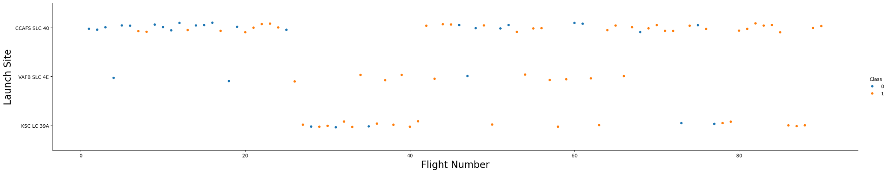
Flight Number vs. Launch Site
Explanation
The earliest lights all failed while the latest lights all succeeded.
The CCAFS SLC 40 launch site has about a half of all launches.
VAFB SLC 4E and KSC LC 39A have higher success rates.
It can be assumed that each new launch has a higher rate of success

Slide 19
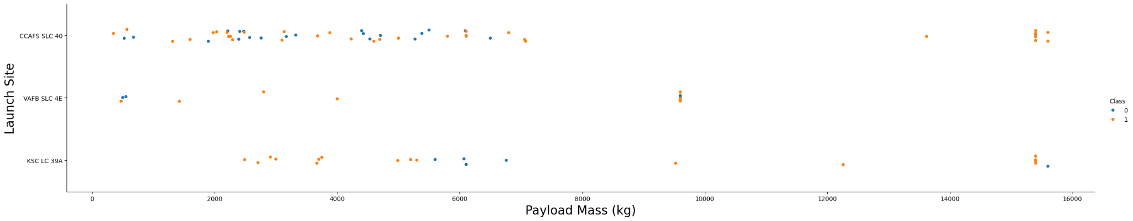
Payload vs. Launch Site
Explanation
For every launch site the higher the payload mass, the higher the success rate.
Most of the launches with payload mass over 7000 kg were successful.
KSC LC 39A has a 100% success rate for payload mass under 5500 kg.

Slide 20
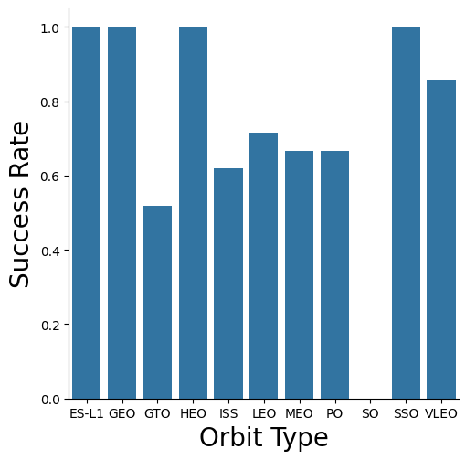
Success Rate vs. Orbit Type
Explanation
Orbits with 100% success rate
ES-L1, GEO, HEO, SSO
Orbits with 0% success rate
SO
Orbits with success rate between 50% and 85%
GTO, ISS, LEO, MEO, PO

Slide 21
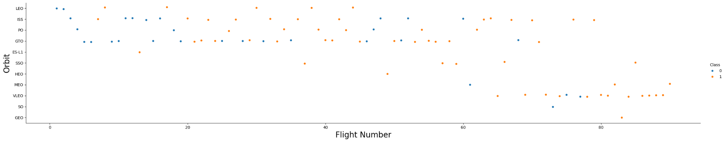
Flight Number vs. Orbit Type
Explanation
In the LEO orbit the Success appears related to the number of flights; on the other hand, there seems to be no relationship between flight number for the GTO orbit type.

Slide 22
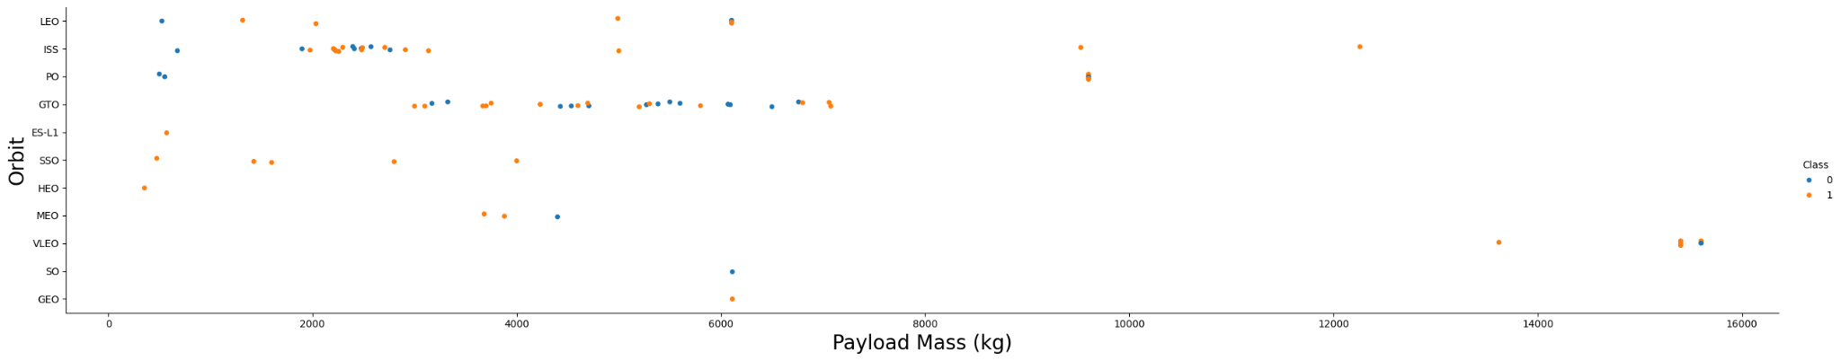
Payload vs. Orbit Type
Explanation
Heavy payloads have a negative influence on GTO orbit types and positive on GTO, and Polar LEO (ISS) orbit types.

Slide 23
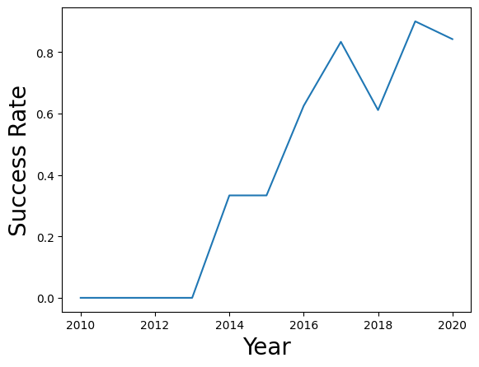
Launch Success Yearly Trend
Explanation
The success rate since 2013 increased until 2018 where it saw a slight decline.
The success rate continues to improve from 2018 to 2020.

Slide 24
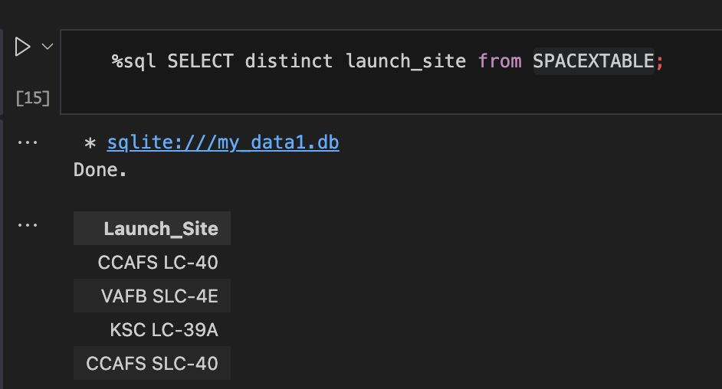
All Launch Site Names
There are four total site names in the dataset.

Slide 25
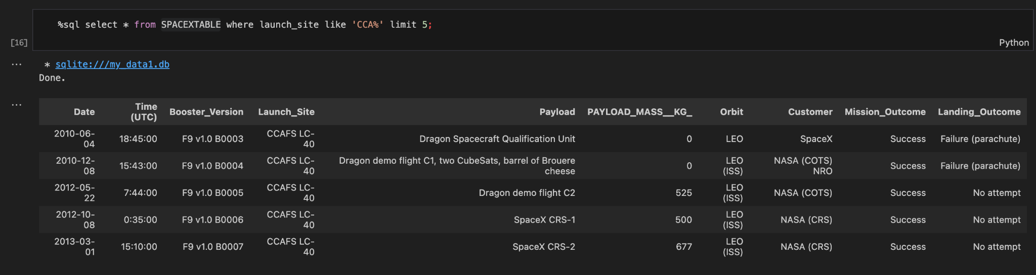
Launch Site Names Begin with 'CCA'
This shows launch site names that begin with CCA and limits the results to 5 rows.

Slide 26
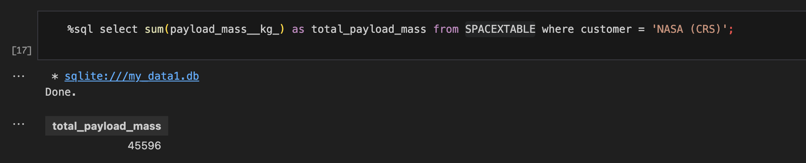
Total Payload Mass
The total mass payload is 45,596 KG

Slide 27
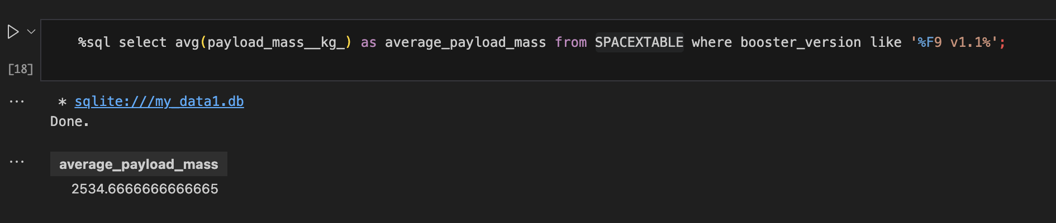
Average Payload Mass by F9 v1.1
The Average mass payload for Falcon 9 launches is 2,535 KG

Slide 28
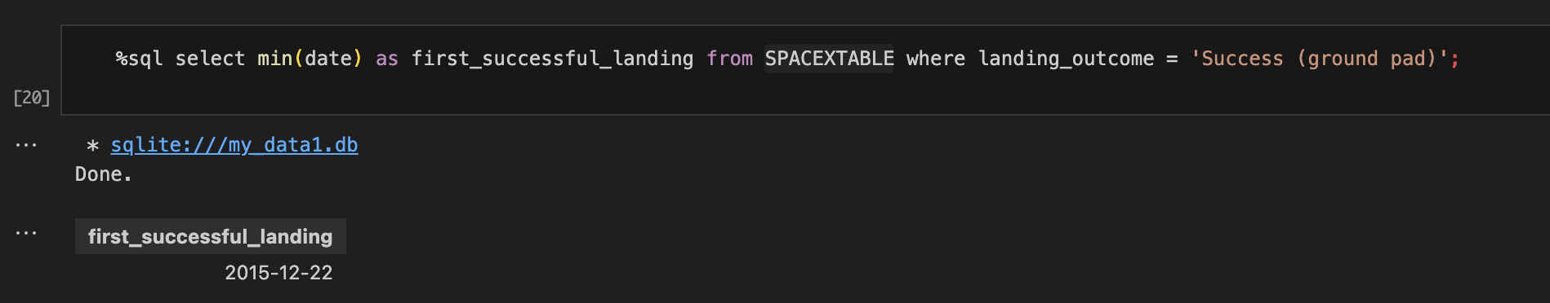
First Successful Ground Landing Date
The first successful ground landing was 2015-12-22

Slide 29
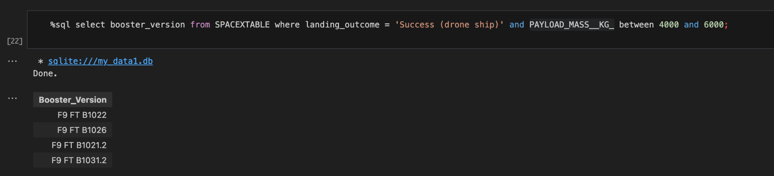
Successful Drone Ship Landing with Payload between 4000 and 6000
This shows all booster versions with payloads between 4,000 KG and 6,000 KG wich successful landings.

Slide 30
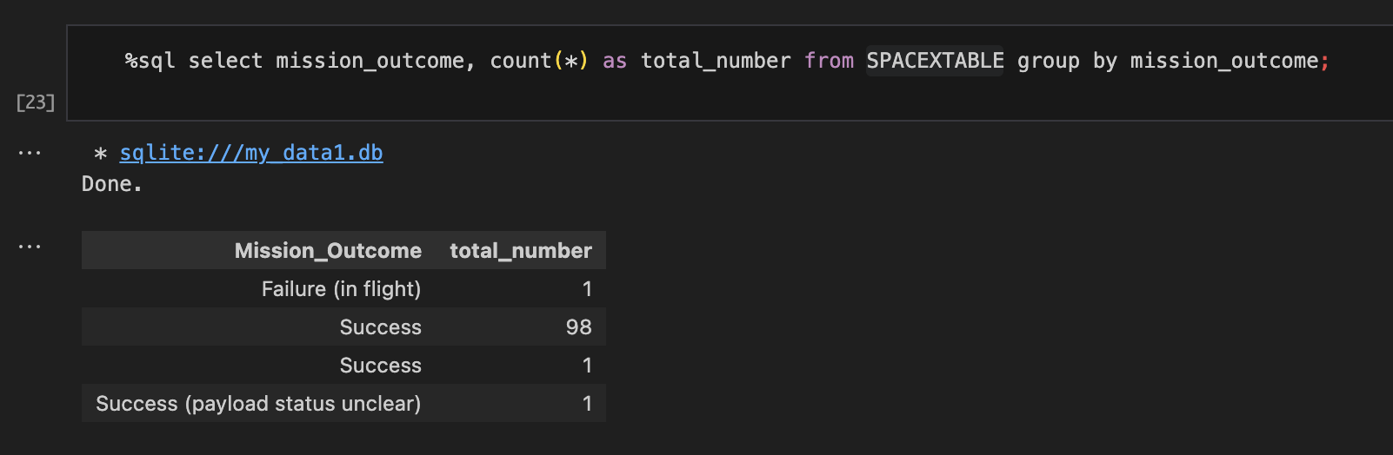
Total Number of Successful and Failure Mission Outcomes
Summary totals from the dataset. The majority of mission outcomes were successful.

Slide 31
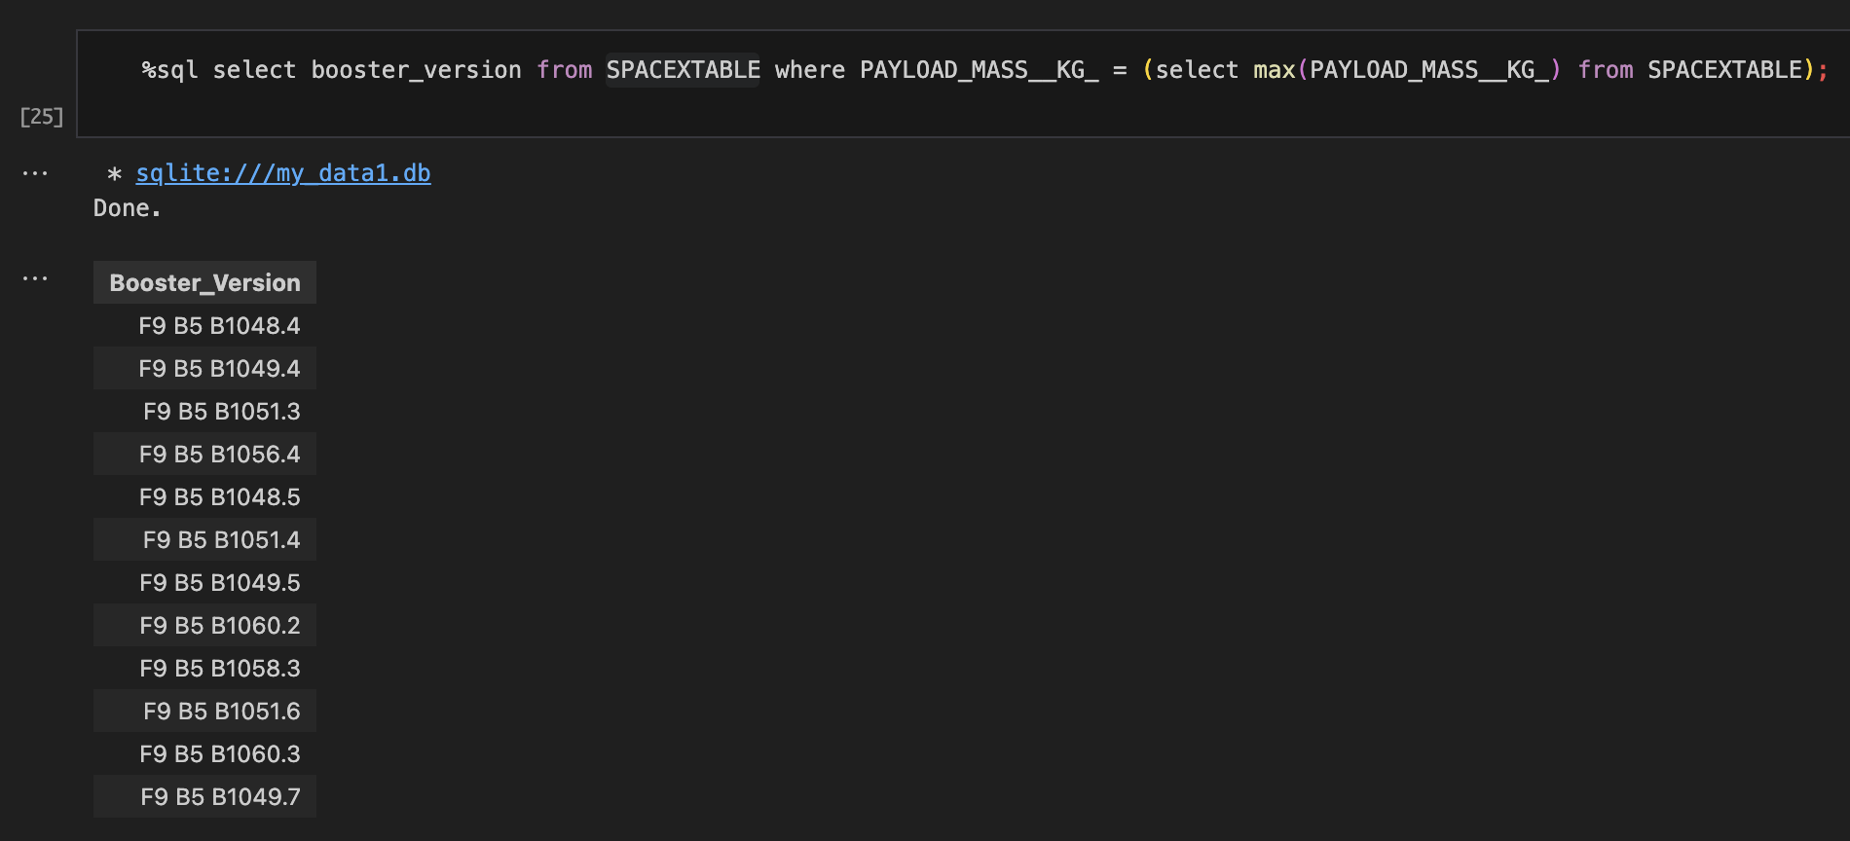
Boosters Carried Maximum Payload
A full list of boosters that carried their maximum payload

Slide 32
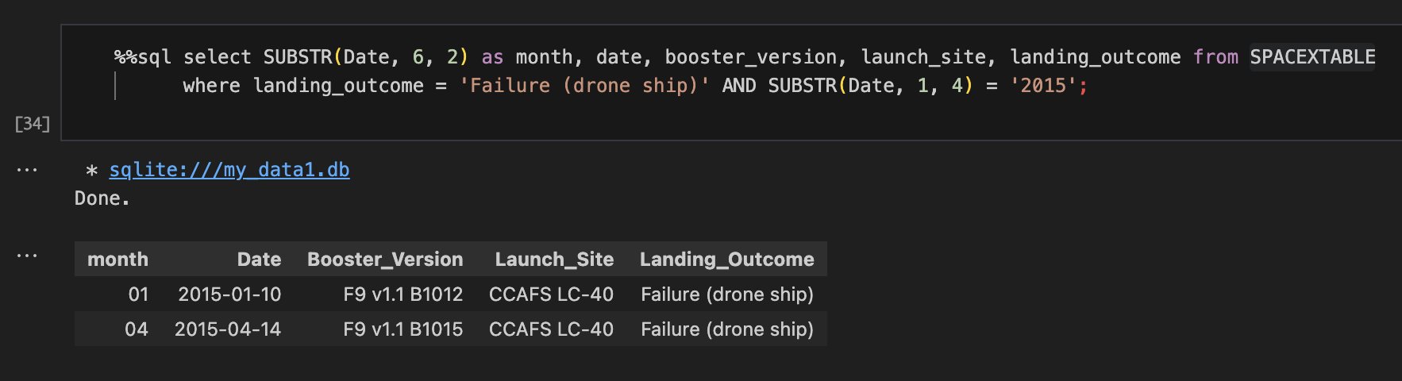
2015 Launch Records
Shows all failed drone to ship landing outcomes in 2015

Slide 33
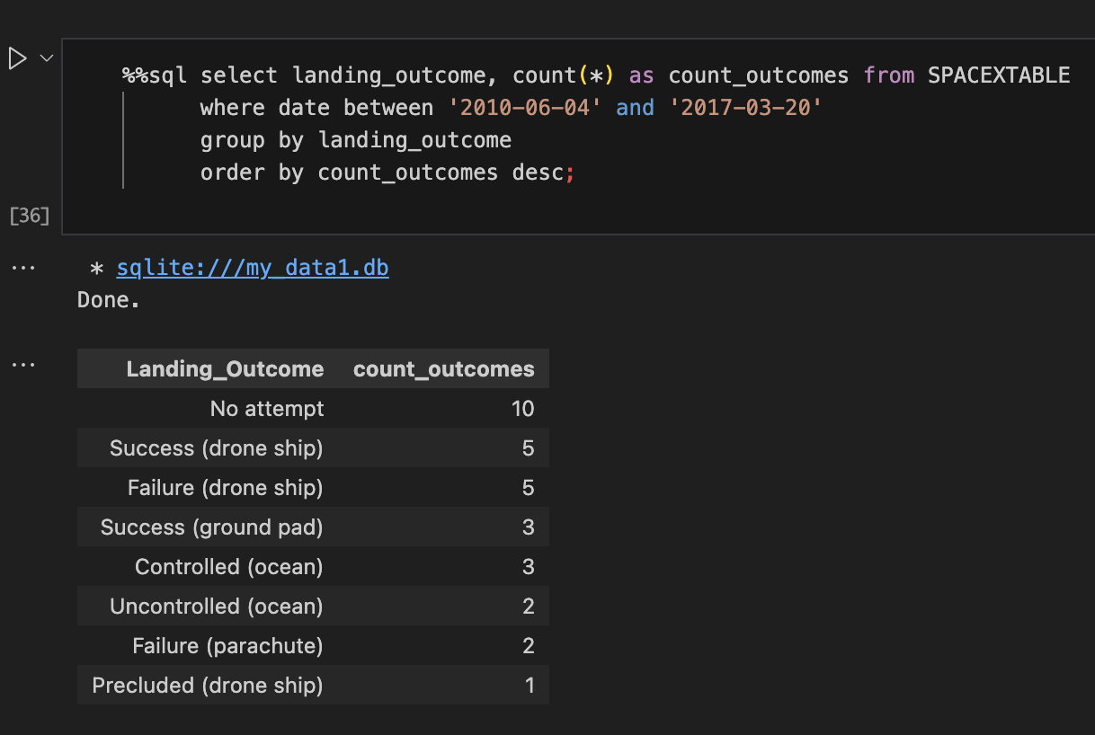
Rank Landing Outcomes Between 2010-06-04 and 2017-03-20
Ranks the count of landing outcomes (such as Failure (drone ship) or Success (ground pad)) between the date 2010-06-04 and 2017-03-20, in descending order.

Slide 34

Section 3

Slide 35
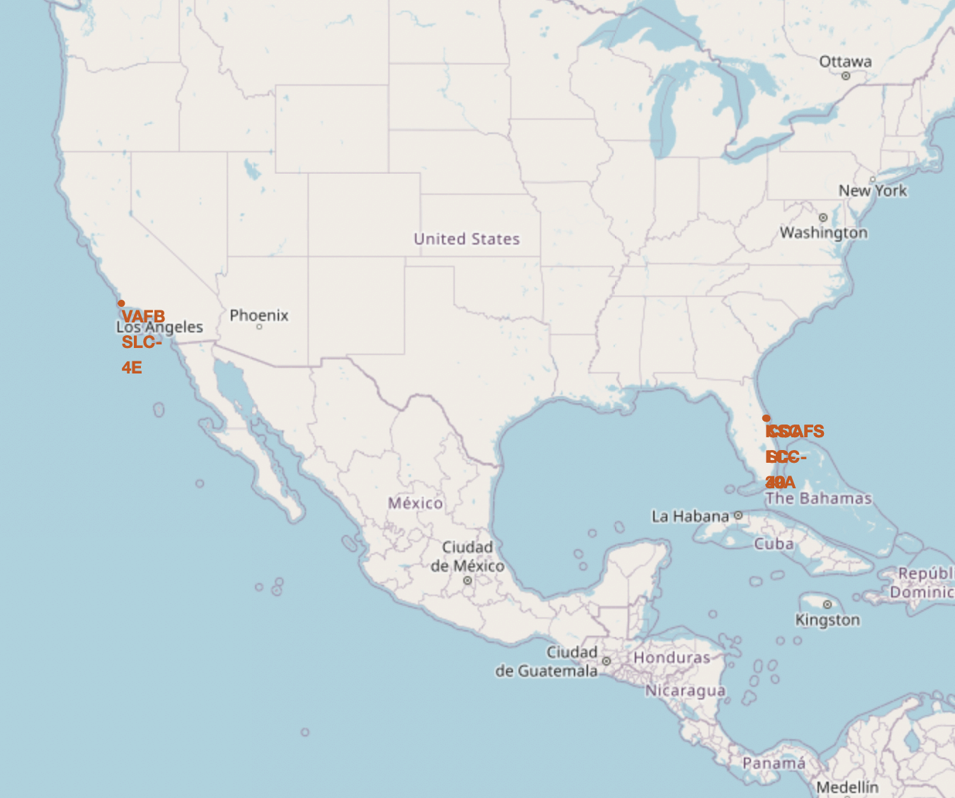
SpaceX Launch Sites
Proximity to the Equator
Most launch sites are located near the equator, where Earth's rotation is fastest (1,670 km/h).
Launching from the equator provides an initial velocity advantage due to inertia, helping spacecraft achieve and maintain orbit efficiently.
Proximity to the Coast
All launch sites are positioned close to the coast.
Launching rockets over the ocean reduces the risk of debris falling or explosions occurring near populated areas.

Slide 36
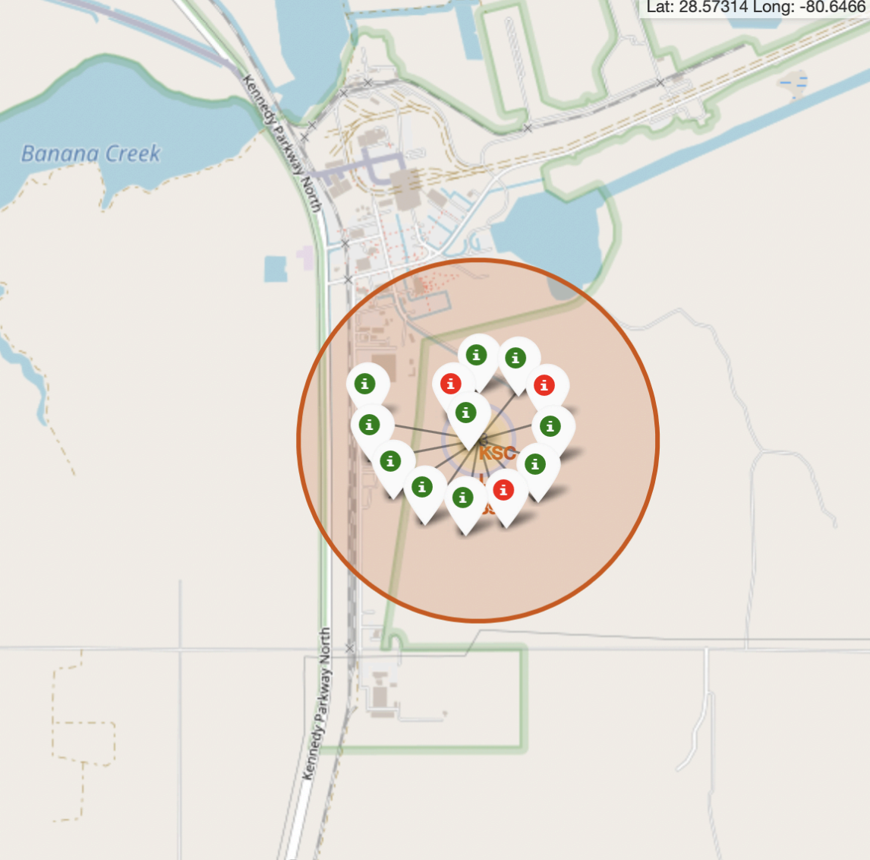
Launch Success Rate
Identifying Success Rates with Color-Labeled Markers
Green Marker: Indicates a successful launch.
Red Marker: Indicates a failed launch.
These markers help visualize which launch sites have higher success rates.
High Success Rate at KSC LC-39A
The launch site KSC LC-39A has a notably high success rate.

Slide 37
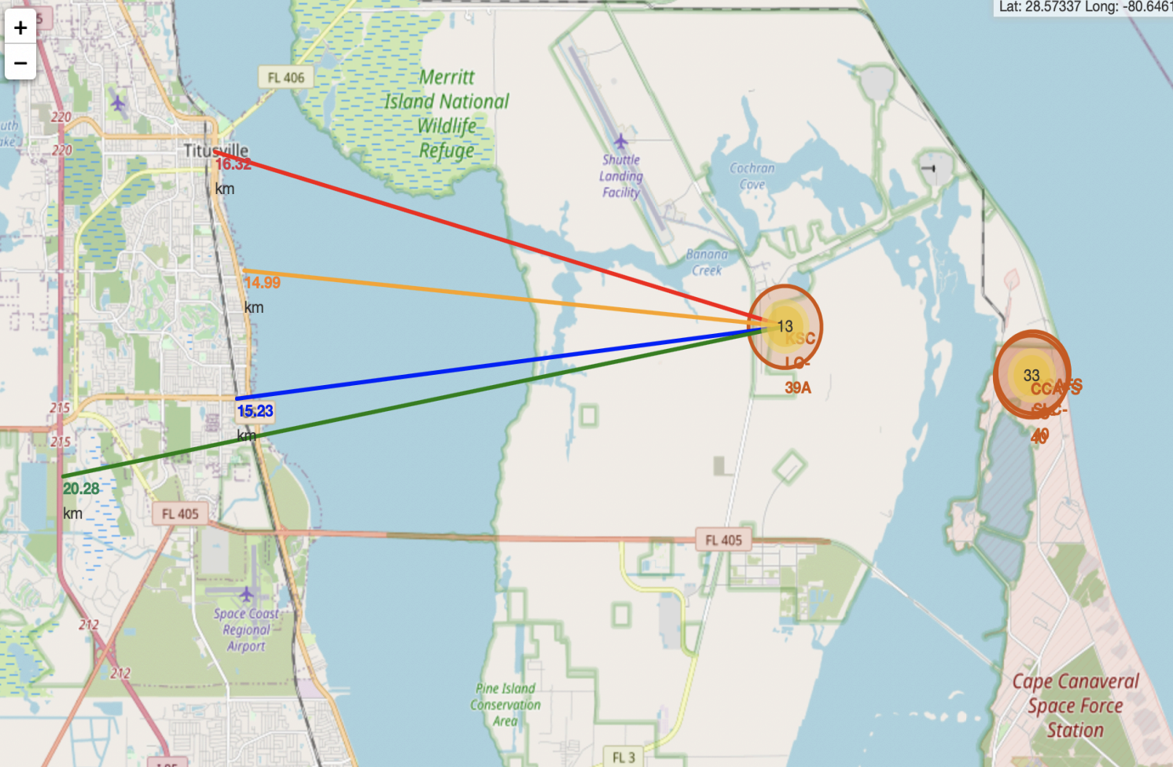
Proximity of Launch Site to Populous Areas
Proximity of Launch Site KSC LC-39A to Key Locations:
Close to a railway: 15.23 km
Close to a highway: 20.28 km
Close to the coastline: 14.99 km
Close to the nearest city, Titusville: 16.32 km
Potential Risk of Failed Rockets:
A failed rocket traveling at high speed can cover 15-20 km in seconds, posing a potential danger to populated areas.

Slide 38

Section 4

Slide 39
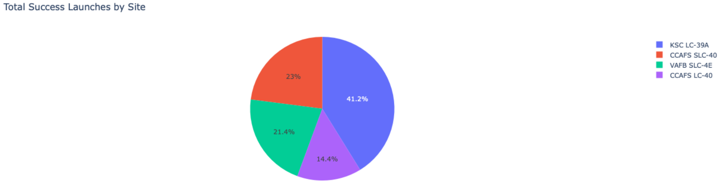
Total Success Launches by Site
This pie chart shows that the KSC LC-39A launch site has the highest number of successful launches.

Slide 40
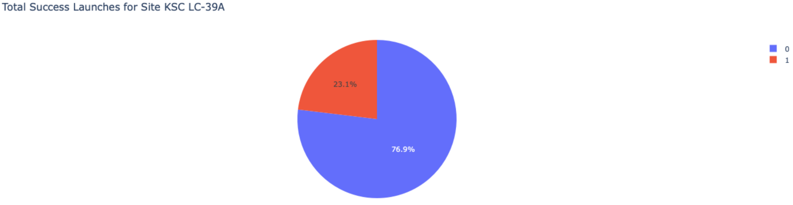
KSC LC-29A Launch Success
This pie chart shows that 76.9% of launches from KSC LC-39A are successful.

Slide 41
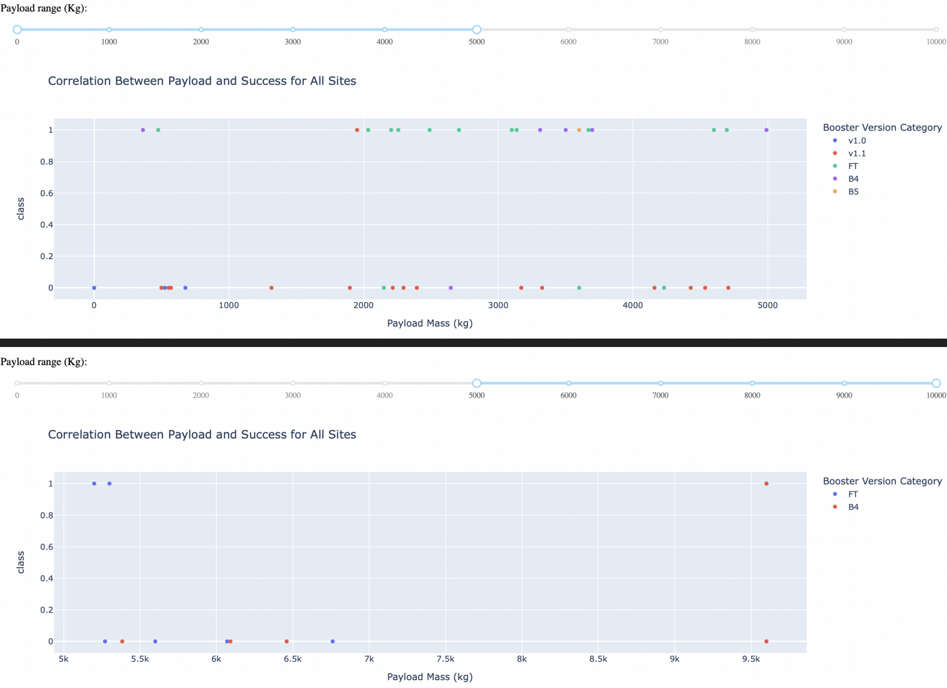
Payload Mass vs Launch Success
These plots show that launches with payloads between 2,000 KG and 5,500 KG are the most successful.

Slide 42

Section 5

Slide 43
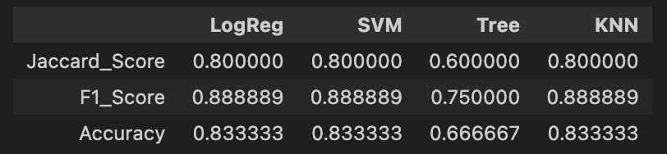
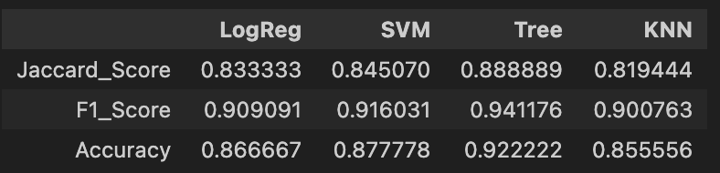
Classification Accuracy
Uncertainty in Test Set Results:
The test set scores do not clearly indicate which method performs best.
Impact of Small Test Sample Size:
The test set contains only 18 samples, which may lead to similar scores across methods.
To address this, all methods were tested using the entire dataset.
Decision Tree Model Performance:
The Decision Tree Model achieved the highest scores and best accuracy, confirming it as the most effective model.
Scores from the test Dataset
Scores from the whole Dataset

Slide 44

Confusion Matrix
Explanation
Examining the confusion matrix, we see that logistic regression can distinguish between the different classes. We see that the major problem is false positives.

Slide 45
Conclusions
Best Performing Model:
The Decision Tree Model is the most effective algorithm for this dataset.
Influence of Payload Mass:
Launches with lower payload mass tend to have higher success rates compared to those with larger payload mass.
Geographical Factors:
Most launch sites are located near the Equator, and all are close to the coast.
Trends in Success Rate:
The success rate of launches has increased over the years.
Top-Performing Launch Site:
KSC LC-39A has the highest success rate among all launch sites.
Orbit Success Rates:
Orbits ES-L1, GEO, HEO, and SSO have achieved a 100% success rate.

Slide 46
Appendix
GitHub Project
Coursera Applied Data Science Capstone Course
SpaceX.com

Slide 47


